Slide 1

General Service Representative
Original Presentation Created by Bob M.
Adapted and Presented by Kim R. with Permission

Slide 2

Our Three Legacies
The A.A. Service Structure
  GSR’s Role Within the A.A. Service Structure
GSR’s Responsibility
Questions and Answers?

Slide 3

Recovery – Twelve Steps
Unity – Twelve Traditions
Service – Twelve Concepts

Slide 4





12 Traditions
12 Concepts
12 Steps

Slide 5

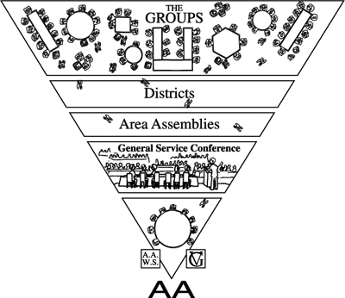

Slide 6
The A.A. Group
Any group of alcoholics gathered together for sobriety may call themselves a group provided that, as a group, they have no other purpose or affiliation.
Groups participate in the A.A. Service Structure
Twelve Concepts for World Service
Concept Twelve, Warranty Six

Slide 7
A Meeting
Meetings are similar to groups in that they gather together for no other purpose than sobriety,
BUT:
Meetings do not participate in the A.A. Service Structure nor have GSR’s
Twelve Concepts for World Service
Concept Twelve, Warranty Six

Slide 8
Concept I
“Final responsibility and ultimate authority for A.A. World Services should always reside in the collective conscience of our whole Fellowship.”
  A.A. World Service Manual

Slide 10
A Voice - GSR’s can speak at these meetings
  Home Group – personal conscience
  District – home groups conscience
  Assemblies – home groups conscience
  Delegates Workshop – home groups conscience

Slide 11
A Vote – GSR’s can vote at these meetings
  Home Group – personal conscience
  District – home groups conscience
  Assemblies – home groups conscience
  Delegates Workshop – home groups conscience

Slide 12
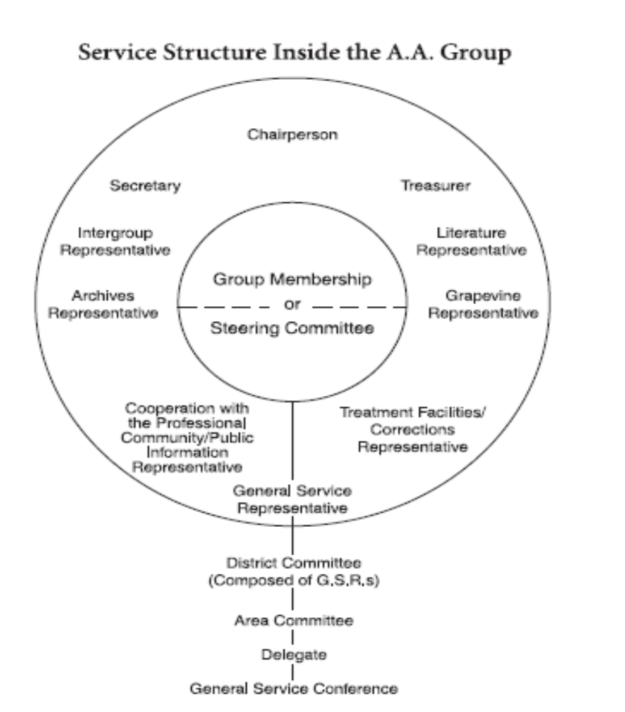
Home Group Service
  Personal Voice
  Personal Vote

Slide 13
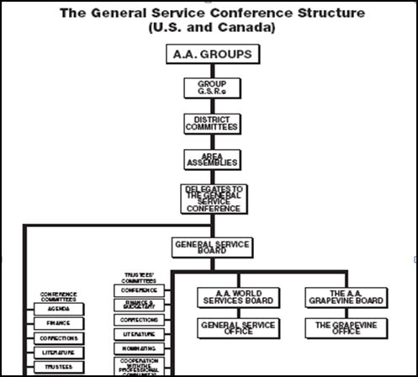
Within A.A.
  Groups Voice
  Groups Vote

Slide 14

Steward to the Home Group
Chair of the Home Group Business Meetings
Trusted Servant
What to Attend

Slide 15

Home Groups Primary Purpose
  Carry A.A.’s message within and beyond the four walls
  Participate in District Committees
    Corrections
    Treatment
    Public Information
    Central Office
    Hotline

Slide 16
Keep the Doors Open
Responsibility Statement
When anyone, anywhere reaches out for help
I want the hand of A.A. to always be there;
and for that I am responsible!

Slide 17
Fellowship
  Strangers made to feel welcome?
  Are newcomers greeted and introduced?
  Do visitors get approached by Home Group members?

Slide 18

Schedule monthly business meetings
  Prepare agenda
  Facilitate meeting
  Discuss self support pamphlet – and prudent reserve
  Request treasurers report
  Encourage participation

Slide 19

Active and vital link from Home Group to Fellowship
The voice of the group conscience
Two-way communication link between Fellowship and Home Group

Slide 20
Active and Vital Link from Home Group to Fellowship
Announcements
  District
  Area

Slide 21
Voice of the Group Conscience
  District Meetings
  Area Assemblies
  Delegates Workshop
  Service committee break-out sessions – Assemblies
  Participate in District and Area service events

Slide 22
Communication link between Fellowship and Group
  Primary contact for District, Area, GSO and Directory
  Service opportunities within the service structure
  Distributes event fliers
  Reports on District and Area

Slide 23

District Meetings – Monthly (2nd Sunday)
A.A. Service Conferences – Spring and Fall
Area Assemblies – 4 per year
Forums – Annually
Delegates Workshop – Annually

Slide 24

7th Tradition
Special Contribution
Personal Pay

Slide 25















